Slide 1
Left Brain / Right Brain: Entering the Debate on Cerebral Asymmetry
Paul Greenberg, 2015
Anoka Ramsey Community College

Slide 2
The Left vs. Right Controversy
No, the other controversy.
http://cercor.oxfordjournals.org/content/11/9/868.full (Watkins et.al, 2001)
How different are different parts of the brain?

Slide 3
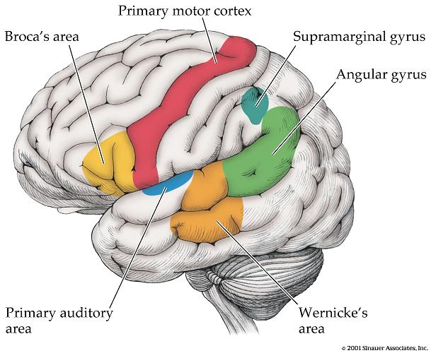
Presentation Goals
Approach the Cerebral Asymmetry Debate
What is a brain/cortex?
Main issues
History of debate
Structural evidence
Functional evidence
How methods matter
Popular vs. Scientific usage

Slide 4
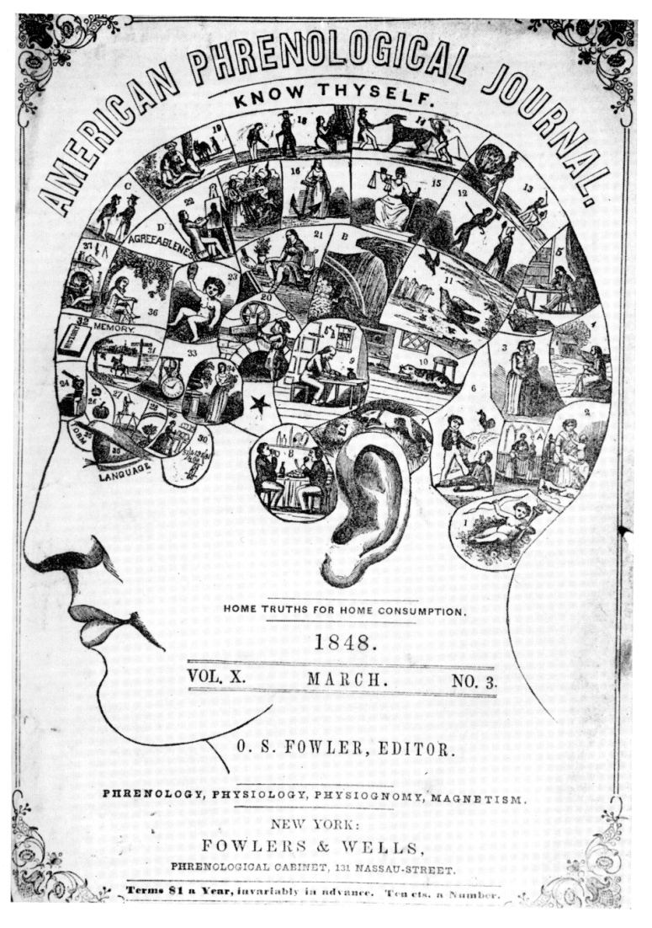
Selective Origins of Cerebral Asymmetry 225 Years of Inquiry
Phrenology (less correct)
Franz Gall & Johann. Spurzheim, 1790-1820
Skull features show functional localization (1/2 wrong)
Functional localization (more correct)
Brain damage shows functional localization
Paul Broca 1860s (speech)
Carl Wernicke 1870s (listening)
Supports Funct. Loc. And C. A.

Slide 5
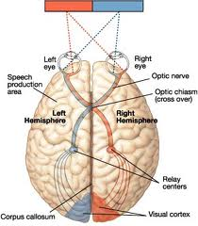
Structural Asymmetry
Premise: structural asymmetry predicts functional asymmetry
Famous discoveries
Visual System is Crossed
Motor System is Crossed (and Handedness)
R. Sperry (Split Brain)
Gray Matter Volume:
More in Right frontal lobe
More in Left occipital lobe
Asymmetry exists

Slide 6
Functional Asymmetry / Dominance
Left
Language (speech, grammar, syntax)
Positive Emotion
Right
Language (rhythm, sound)
Negative Emotion, Reading Emotion
Argued
RH for general emotion, or divided emotion
Global Vigilant Awareness, Spatial Coordinates
Metaphor, Context, Implicit Meaning, Living Objects
Creativity, Personality Types - Popular Myths
Narrow Focused Attention
Tools & Machines
Role in Pathology, Indiv Differences
RH Prosocial
LH Antisocial

Slide 7
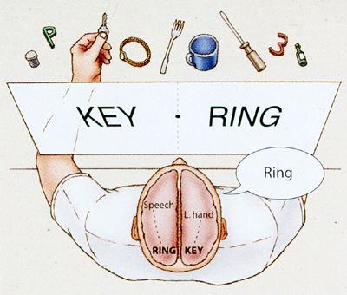
Methods
Neuropsychology
Brain Damage
Cognitive Testing
Neurosurgery (Sperry)
Split Brain
Imaging, Electrophysiology, cellular/molecular, neuroanatomy and more

Slide 8
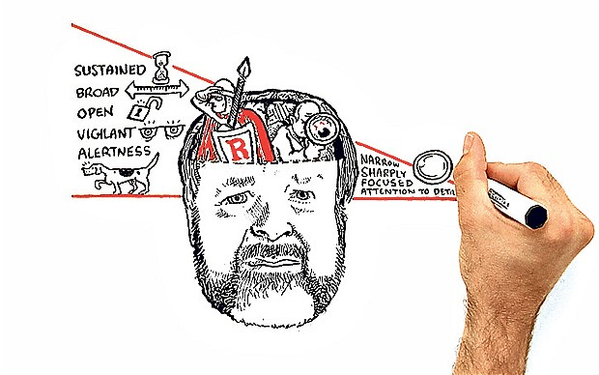
Conclusion
Cerebral asymmetry well established
Structural
Functional
Varying methods and interpretations
Relation to psychopathology
Popular over-generalizations are prevalent
Keep Reading!
Iain McGilchrist
https://www.youtube.com/watch?v=dFs9WO2B8uI

Slide 9
References
Demaree, H. a, Everhart, D. E., Youngstrom, E. a, & Harrison, D. W. (2005). Brain lateralization of emotional processing: historical roots and a future incorporating “dominance”. Behavioral and Cognitive Neuroscience Reviews, 4(1), 3–20. http://doi.org/10.1177/1534582305276837
Fitzakerley, J. (2015, January 1). Lateralization of Cortical Function. Retrieved March 27, 2015. http://www.d.umn.edu/~jfitzake/Lectures/DMED/SpeechLanguage/CorticalS_LAreas/Lateralization.html
Hecht D (2014). Cerebral lateralization of pro- and anti-social tendencies. Experimental Neurobiology , 23(1):1-27
Hervé, P.-Y., Zago, L., Petit, L., Mazoyer, B., & Tzourio-Mazoyer, N. (2013). Revisiting human hemispheric specialization with neuroimaging. Trends in Cognitive Sciences, 17(2), 69–80. http://doi.org/10.1016/j.tics.2012.12.004
Kolb, B., & Whishaw, I. Q. (2009). Fundamentals of human neuropsychology. New York, NY: Worth Publishers.
Nielsen, J. a, Zielinski, B. a, Ferguson, M. a, Lainhart, J. E., & Anderson, J. S. (2013). An evaluation of the left-brain vs. right-brain hypothesis with resting state functional connectivity magnetic resonance imaging. PloS One, 8(8), e71275. http://doi.org/10.1371/journal.pone.0071275
Van Whye, J. (1999, January 1). What did phrenologists actually do? Retrieved March 27, 2015.http://www.historyofphrenology.org.uk/overview.htm
Watkins, K. (2001). Structural Asymmetries in the Human Brain: A Voxel-based Statistical Analysis of 142 MRI Scans. Cerebral Cortex, 11(9), 868-877.

